Slide 1



Introduction to Python

Slide 2
Why Python
Popular language for handling large data sets and data cleaning (#2 on Github)
Available on all platforms and comes with a lot of API’s
Open source, interpreted (instant) not compiled for OS but for VM
Big online community
Easy to learn, readable syntax, procedural (functions and o-o classes)
Reasonably fast (quicker than R, slower than C)
Choose stable 2.7 v latest 3.x (includes PIP to install packages)

Slide 3
Getting Started
Environment used is Anaconda Spyder for Python v3
Contains the IDE and libraries
Type help(command) or ?command for description and examples
Type help(library) for methods
Auto-complete or suggest args
Use arrows for history
Timing commands
import timeit or time
timeit('"-".join(str(n) for n in range(100))', number=10000)
start_time = time.time()
… run program …
print("--- %s seconds ---" % (time.time() - start_time))

Slide 4
Differences between Python and other languages
Indentation is very important, not just for readability but for syntax
Comment using # anywhere in a line or docstrings over multiple lines
Python indexes from zero (and -1)
Python passes by object reference
immutable arguments (int, string, tuple) ≈ call by value
mutable arguments (lists, dataframes) call by reference
using x = y means x can be a copy of y i.e. it mirrors any changes

Slide 5
Importing Libraries
Many packages exist with specific sets of commands and functions that we can draw on. There are over 600 in Anaconda. They are basically collections of modules containing functions and help files in a directory structure
Useful ones include math, random, pandas (series and df), scipy (scientific calculations), numpy (arrays), scikit-learn (ml), glob (directory searching), os (file manipulation), matplotlib (plotting), statsmodels (modelling), seaborn (visualisations), bokeh (dashboards), blaze (distributed ds), scrapy (web scraping), sympy (calculus, LaTeX) and regex (string search)
At start of program use import command:
import pandas as pd … no need to specify where … better than from pandas import *
import numpy.linalg as npl numpy.random as npr
dir(npl) or help(pd)
from pandas.util.testing import makeCustomDataframe as mkdf

Slide 6
Input
internal_name = pd.read_csv(‘/path/to/file.csv’, header=None)
for column index: names=list(‘abcde’) or index_col=‘colname’ … not unique
skiprows = [0,3] or skiprows = 5
to read the first part: nrows=100 … very useful to examine a big file
na_values = [‘na’, ‘null’, ‘999’, ‘-1’] or even dict for each column
14 pd.read_ choices include: Excel, JSON, Clipboard, HTML, SQL, SAS, …
pwd and os.chdir(‘/path/to/file/’)
content = [i for i in open(path+file, mode)] … as a string
mode=“r” (read) “a” (append) “w” (write) “x” (create) “t” (text) “b” (binary)
content = [int(i.strip()) for i in open(path+file)] … as numbers
data = np.loadtxt(path+file, delimiter = ‘.’)

Slide 7
Practical Session 1
Install Anaconda (Python, Jupyter) and data (DC workshop titanic.csv or larger titanic.xls from email)
Anaconda -> Jupyter -> Browser -> New
Note: ctl+enter to execute and shift+enter for new cell
ctl+v to paste, watch three types of single quote … logout and x
.ipynb file remembers commands but need to rerun
ls
import pandas as pd
ti = pd.read_csv(‘titanic.csv’)
ti2 = pd.read_excel(“titanic.xls”) => note lowercase col names
ti.head()

Slide 8
Output
data.to_csv(path+filename, sep=‘\t’) … for tab-delimited
na_rep=‘NA’ … default is blank
index=False, header=False
columns=‘a’ for a subset
19 pd df.to_ choices include: Excel, dict, JSON, Clipboard, HTML, SQL, string, LaTeX, …
np.save(‘extname’, intname) and arr1 = np.load(‘extname.npy’)
open()
f = open(path+file, mode)
f.write(“filename")

Slide 9
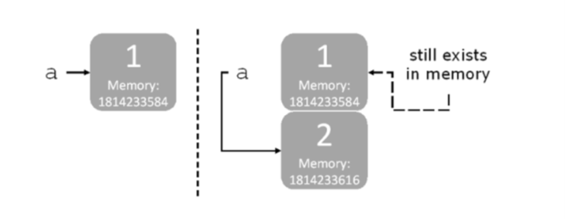
Variables, reserved words and type conversion
a = 1 … a = 2
Placeholders or labels, not boxes
Start with letter or _ and case sensitive
Contains only letters, numbers or _
35 reserved keywords plus ‘print’ and ‘exec’
also built-in functions like ‘Data’, ‘array’, ‘range’
system and class names and constants, math names etc. such as ‘pi’, ‘exp’, ‘e’, ‘floor’
Types: int, float, complex, decimal, bool, string, iterators
Type conversion 3/2 v 3//2
Implicit and explicit casting 3.0/2 or float(3)/2

Slide 10
Assignment and Equality 1
== (default as it can be redefined) checks for equality, i.e. identical twins are equal
is() compares identity, i.e. each twin is a different person
a = [1, 2, 3]
b = a … not a copy but a binding between a target and an object
c = list(a)
a == b is true and a is b is true
a == c is true but a is c is false, i.e. two different objects with the same contents
list1 = []
list2 = []
list3 = list1
list1 == list2 ? list1 is list2 ? list1 is list3 ?

Slide 11
Assignment and Equality 2
Check with id() v type()
Solutions
x = y.copy() or x = copy.copy(y)
x = y[:]
Compare Java == for location and .equals() for value as overidden in parent class
Shallow and deep copy differ in compound objects like lists or classes
x = copy.deepcopy(y) avoids loops and memory overrun
None (Python) v NaN (pandas) v nan or ma (numpy masked arrays)
del(object) for variables , lists, etc.
.isnull() alias of .isna(), .dropna(), .fillna() or redefine in read_csv (slide 6) and .to_csv (slide 8)

Slide 12
Operations
Arithmetic: + - * / % ** //
Assignment: = and compound (arithmetic and bitwise), e.g. += or **=
Comparison: == != > < >= <=
Logical: and or not
Identity: is is not
Membership: in not in
Bitwise: & (and) | (or) ^ (xor) ~ (not, invert) << (zero fill left shift) >> (signed right shift)

Slide 13
precedence
Scope > (group) > string conversion > fn(), slice[a:b], arr[] sub, x.attribute > await > ** > ~ bw not, unary ±x > * @ / // % > +- > left/right shift > & bw and > ^ bw xor > | bw or > member (in, is), relationship, ==, != > ! Logical not > && logical and > || logical or > ternary if > lambda
Python evaluates expressions from left to right. Notice that while evaluating an assignment, the right-hand side is evaluated before the left-hand side
Ternary if: true_action if condition else false_action (equivalent to Java ?: command)

Slide 14
Collection Objects
Object | Ordered | Mutable | Allow Duplicates | Indexed | Notation
List | y | y | y |  | [ ]
Tuple (~fixed list) | y | n:values, y:mutable member objects | y |  | ( )
Set (unordered list) | n | y | n | n | { }
Dict | n (cannot rely or predict 100%) | n:keys, y:mutable values | n | y | { k : v }

Slide 15
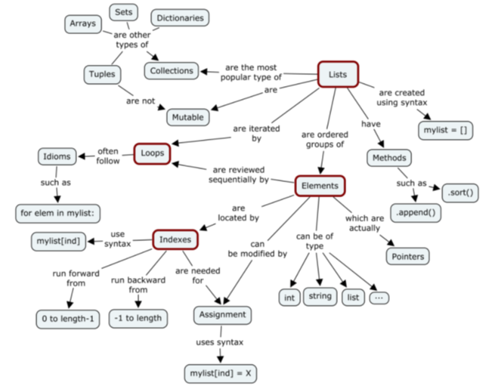
Structures 1
Lists are mutable
even = [2, 4, 6, 8, 10]
even[2:4] = []
even is now [2, 4, 10]
Tuples are immutable
sentence = (‘This’, ‘is’, ‘a’, ‘sentence’)
Dicts (associative arrays) are mutable
can add or delete entries or assign a new value to a key
duplicate keys are not allowed, hashable ≈ immutable
col_values = {‘Green’:1, ‘Red’:2, ‘Blue’:7, ‘Yellow’:4}
Pandas series (1D array with index), dataframes (2D array with row and column) and panels (3D array with item, major, minor) are mutable
d = {'col1': [1, 2], 'col2': [3, 4]}
df = pd.DataFrame(data=d)
NP array of one type (coerced to string) v PD series of multiple types

Slide 16
Structures 2
Series and Dataframes
ser1 = pd.Series([1,2,3,4,5,6]) … returns zero-based index and values
ser2 = pd.Series([1,2,3], index = [‘a’, ‘b’, ‘c’]) … returns customised index and values
operations automatically align on indices
df1 = pd.DataFrame(dict or nested list) e.g. {‘a’: np.arange(10), ‘b’: np.arange(10)} … don’t have to match size unless for some ops
Other objects include: Sets, Vectors, Matrices, Arrays, Ranges, Byte Array, Frozen Set, Class
Strings and literals are immutable
greeting = ‘Hello world!’
use \ to add special characters
\n and \t
docstring ‘’’ multiple lines with spacing ‘’’
concatenate + and repeat *
print (ord(‘A’)) v print (chr(65))

Slide 17
Slicing and selecting lists
even = [2, 4, 6, 8, 10, 12, 14, 16, 18, 20]
even[:3] returns a sublist [2, 4, 6] stopping before [3] but using labels is inclusive
even[::3] returns [2, 8, 14, 20]
even[0:1] or just even[0] gives [2]
even[2:] returns [6, 8, 10, 12, 14, 16, 18, 20]
even[-2:] gives [18, 20]

Slide 18
Practical Session 2
ti[0:9]
=> first nine lines
ti[:3] v ti[::3]
=> first three v every third
ti[ti.Age>62].sort_values([‘Age’])
=> 18 oldest: 16 male, only oldest survived

Slide 19
Slicing and selecting dataframes Indices provide metadata, enable alignment and allow subsetting
df = pd.DataFrame(np.random.randn(5, 4), columns=list('ABCD'))
df.iloc[:,0:2] gives the first two columns but df.loc[:,’A’:’C’] returns three columns, i.e. both start and stop and df[1][0] for first item of sublist
Non-contiguous [[0,4,6],2] and similar for higher dimensions
Boolean x[x>0] picks just the positive elements
df[df>0] v df.where(df>0)

Slide 20
Practical Session 3
ti.iloc[-1]
=> last 886 or 1308
ti.iloc[887]
=> index error
ti.where(ti.Age>62)
=> mask

Slide 21
Data Exploration
df.columns, df.info(), df.head(), df.tail(), df.mean(), df.median(), df.mode() with () or (axis = ‘columns’)
.describe(), .value_counts(), df.dtypes, df.count(), df.col or series.is_unique (note: attribute, not method, hence no function brackets), df.nunique(), df.isnull().any(), .all(), len(df) – df.count()
df.var.duplicated().sum() and df.drop_duplicates(‘var’)
.hist(), .boxplot(), .crosstab(), .plot()
if extremes are not outliers, consider a log transformation:
df[‘varlog'] = np.log(df[‘var'])
df[‘varlog'].hist(bins=20)
If Gaussian, maybe use sklearn.preprocessing.scale(data, axis=0, with_mean=True, with_std=True, copy=True)
standardize = (raw-mu)/sigma … mu is average, sigma is std deviation
or normalise = (raw-min)/(max-min)
df.query(‘a in b’) is equivalent to df[df.a.isin(df.b)]
df.apply(lambda x: sum(x.isnull()),axis=0)
check for other values that could be mv in the context of the data, e.g. 0 or -1
careful action: df[‘varname'].fillna(df[‘varname'].mean(), inplace=True)
or: df[‘varname'].fillna('No',inplace=True)
for categorical: df['Gender'].fillna(df['Gender'].mode()[0], inplace=True)

Slide 22
Practical Session 4
ti.shape => (887, 8) or (1309, 14)
ti.columns => 8 or 14 names
ti.info() => range, columns, non-null and type
ti.describe() => stats for numerical
ti.head(10) => first 5 or specified
ti.isnull().sum()
ti.Age[33]=None and redo above (was 66.0) or ti2.isnull().sum()
type(ti) => Dataframe
type(ti.iloc[0]) => series, i.e. a slice reduces the dimension
or type(ti[[0]]) => DataFrame
ti.iloc[0,1] v ti.iloc[[0,1]] => one number or two rows

Slide 23
Merging and stacking
On index: pd.merge(df2, df2, on=‘id’)
or left_on and right_on = list … for columns
or left_index and right_index = True … for indices
pd.concat([df1, df2, df3]) … top to bottom
df1.join(df2, suffix=‘text to add to col to stop match’) … side by side
df1.combine_first(df2) … new df which expands df1 indices with df2

Slide 24
Methods 1
.append(element) .clear() .copy()
.index() .insert(pos) .remove(value)
.pop(pos) .count(value) .str.replace([old list], [new list])
.keys(dict) .values(dict) .extend()
df.apply() .groupby() .reverse()

Slide 25
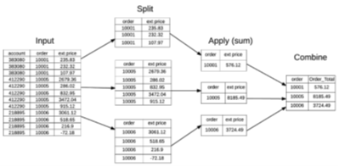
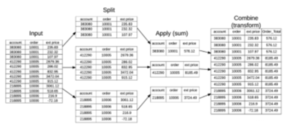
Methods 2
.map(fn, list) applies fn to a list
.reduce(fn, list) result after computation on a list
.filter(fn, list) returns a list where the fn is true
.aggregate() v .filter() v .transform()
1 value, subset, new values for all rows

Slide 26
Methods 3
list1.sort() v y = sorted(x) default is increase by size, alphabetical (caps first) or key
df.sort_index(axis, level, ascending, inplace, kind, na_position, sort_remaining, by)
df.rank() using method=average, min, max, first, dense
.mean(), .std(axis=1), .quantile(0.05)
.corr(), .cov(), .corrwith()
.unique(), .isin([‘string’])

Slide 27
Practical Session 5
ti.Age.duplicated().head() v ti.Age.head() => 5th
ti.Age.head() v ti.Age.rank().head() => value or position
ti.Age.mean() or median or mode or sum or count etc…
ti.Age.corr(ti.Survived) v Pclass.corr => -0.06, -0.34
ti.Pclass.unique() => [3,1,2]

Slide 28
Practical Session 6
ti[['Pclass', 'Survived']].groupby(['Pclass']).mean().sort_values(by='Survived', ascending=False)
ti[['Sex', 'Survived']].groupby(['Sex']).mean().sort_values(by='Survived', ascending=False)
ti[['Siblings/Spouses Aboard', 'Survived']].groupby(['Siblings/Spouses Aboard']).mean().sort_values(by='Survived', ascending=False)
ti[[' Parents/Children Aboard', 'Survived']].groupby(['Parents/Children Aboard']).mean().sort_values(by='Survived', ascending=False)
ti.Name.str.split().str[0].unique() => 17 titles
ti.Name.str.split().str[0].value_counts() => frequency
ti[ti.Name.str.split().str[0]=='the'] => the Countess of …
Missing values:
tot = ti2.isnull().sum().sort_values(ascending=False)
perc = (round(ti2.isnull().sum()/ti2.isnull().count()*100,1)).sort_values(ascending=False)
profile = pd.concat([tot,perc], axis=1, keys=['Total','%'])
profile => 7 x mv% and 7 x 0% … fill, drop or tricky decision on how to clean and knock-on effects

Slide 29
Branching and Conditionals 1
if Boolean:
Action
elif Boolean:
Action
else
Action
state = "nice" if is_nice else "not nice"

Slide 30
Built-in Functions
Note: When using any or all,
remember NaN, NaT, inf != 0
so return true

Slide 31
Branching and Conditionals 2
Initial settings
while condition :
action
update count, break out of loop, continue loop or pass on

Slide 32
Branching and Conditionals 3
Initial
for condition :
action
else:
action
More like an iterator, a counting object using __iter__() and __next__()
range(3) counts over [0, 1, 2] and range(2, 12, 3) counts over [2, 5, 8, 11]

Slide 33
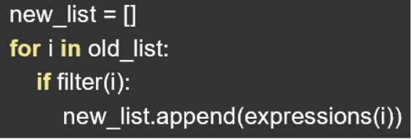
Branching and Conditionals 4
numpy.arange(start, stop, step, dtype) not just integers and returns an ndarray on a half-open interval [start, stop)
If endpoints are important, e.g. for plots, use np.linspace(start, stop, num, endpoint, retstep, dtype) as it is an open interval [start, stop]
List Comprehension is a for loop in one line
new = [expression(i) for i in old_list if filter(i)]
x = [i**3 for i in range(10)]
items = [word[0] for word in sentence]
numbers = [x for x in string if x.isdigit()]
Can include output or predicate conditions:
[n**2 if n%2 == 0 else 0 for n in range(10]
[n**2 for n in range(10) if n%2 == 0]

Slide 34
Advanced Comprehensions
Dict comprehensions
[n : -n for n in range(9)]
Generator expressions
() instead of []
lazy-evaluation: one at a time as needed, not all in memory
e.g. range() or .items(), very memory efficient, can represent an infinite stream
Handy Uses
enumerate() iterable paired with index
zip() iterable to a tuple
iterables are lists, strings, ranges, dicts or file object

Slide 35
Functions – grouping commands for a single purpose
def fn_name(input=default):
… some code …
return(output_tuple)
a, b, c = output_tuple or function can return none if we just want it to do an action
def diff(x):
return x.max() – x.min()
df.apply(diff, axis=1)
Body output v return output for storage, can return a series or df
Default arguments, use immutable objects
Lambda functions e.g. diff=lambda x: x.max() – x.min() … one expression anonymous functions

Slide 36
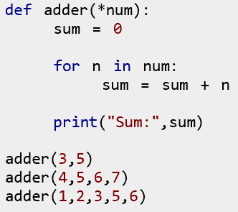

Variable Arguments in Functions
Optional number of arguments for flexible function calling
* for tuple and ** for dict
order is important: individual before * before **

Slide 37
Generator Functions
Use ‘yield’ instead of ‘return’
Returns an iterator but does not execute immediately
Uses next(), control is passed to the caller
Local variables and states are remembered between each call
Cannot be called again, needs to be recreated e.g. ans = gfun()
Can be used in for statements as an iterator, e.g. for item in gfun(): …

Slide 38
Scope
Scope is access depending on where a variable is defined
Variables are pointers to objects in memory
Namespaces are like dicts mapping variable names to objects
x=1 {x:1}
y=x {x:1, y:1}
x=2 {x:2, y:1}
Scope is the hierarchy of namespaces
Global variables outside functions in _main_, local inside functions, nonlocal up nested level
Order is local < nonlocal (enclosing) < global < reserved (built-in from names module)

Slide 39
Date and Time
import datetime as dt
x = dt.datetime.now()
cd = dt.datetime(2018, 12, 25)
x.year x.month x.day x.hour x.minute x.second x.microsecond
x.strftime() with 1 of 24 formats
Pandas
df = pd.DataFrame({'year': [2015, 2016], 'month': [2, 3], 'day': [4, 5]})

Slide 40
Print formatting
Can type just x or print(x)
Combine as in print(x, y, x*y)
Define separator as default is space: print(x, y, z, sep=‘,’)
More refined: old method v Pythonic:
C printf equivalent via overloaded % - print(“format string” % (value tuple))
format string has text and placeholders of form [5 pad or adjust flags][width][.precision][16 types]
e.g. print(“Total: %6d, Percentage: %8.2f” % (1234, 64.7))
best to use format string with {fields to be replaced} embedded in “text”
plus .format() method with positional and name=value keyword arguments and 9 optional formats
e.g. “Total: {0:6d}, Percentage: {1:8.2f}”.format(1234, 64.7)
or “Total: {a:6d}, Percentage: {b:8.2f}”.format(a=1234, b=64.7)
this can become powerful by incorporating dicts, local variables, string methods and formatted string literals

Slide 41
Matplotlib
Very unlike ggplot in R
Stateful, adjust current plot and stack figures on each other
import matplotlib.pyplot as plt
plot.clf() … to clear the plot window
fig = plt.figure(facecolor) … creates a plot window with zoom, save, home
figsize() or plt.subplot()
plt.plot(df.var1, df.var2, ‘ro’) … for red circle scatter plot or use color and marker
plt.ylabel(‘text’), plt.xlabel(‘text’), plt.title(‘text’), plt.text(x, y, ‘text’, font, size)
plt.rectangle(), plt.polygon(), plt.circle(), plt.grid(), plt.legend()
plt.axis([xmin, xmax, ymin, ymax]) , plt.xticks(), plt.yticks() … use arange() or linspace()
plt.close() or plt.savefig(‘name’)

Slide 42
Example function

Slide 43
Practical Session 7
ti.hist() v boxplot() v plot()
MatPlotLib
%matplotlib inline
import matplotlib.pyplot as plt
plt.bar(x=range(3),height=ti.groupby('Pclass')['Survived'].mean())
ti2.groupby('embarked').mean()
plt.bar([‘S’,’C’,’Q’],ti2['embarked'].value_counts())

Slide 44
String manipulation
String literal ‘\\’ first is escape for second to be a backslash
Easier to use raw: r’C:\path\folder’ where \ is backslash
st.split(‘ ‘) to remove space or () to remove whitespace: words = sentence.split()
.split(sep, max) default is whitespace and all occurrences
Immutable so st2 = [x.strip(‘ ‘) for x in st1.split(‘,’)]
+ or .join() and .upper() or .lower() for case
‘text’ in st1 and .count() or st2=st1.replace(‘old’, ‘new’)
No match st1.index(‘text’) returns error but st1.find(‘text’) gives -1

Slide 45
Regular expressions
String to match first or search all of text for a pattern
import re
\s single space and \s+ is one or more spaces
\d digit and \w alphanumeric plus CAP = opposite
Re.split(‘\s+’, pragraph1)
Metacharacters: ^begin $end *>=0 +>=1 ?0 or 1 .single
ca*t matches ct, cat, caat, …
|or \shortcut {number} [xyz]any [a-z]range (group)
Compile to make faster or use flags, e.g. ignore case or multiline

Slide 46
User input
x = input("Enter your name: ") as raw_input from ver2 is deprecated
Prints the text, waits in the shell for keyboard values ending with return
Can then use it as in print("Hello, “, x, ‘!’)
Fill in the blank / braces
person = input('Enter your name: ')
greeting = 'Hello {}!'.format(person)
print(greeting)

Slide 47
Error checking and debugging
Try block to test code and not crash, very useful for file handling
Except [error class] block to handle errors
Else block message if no errors
Finally block to execute code and message regardless of error
try:
Action
except NameError:
Action
except
Action
else:
Action
finally:
Action

Slide 48
Style and efficiency
PEP8 (Pythonesque recommended style rules), JSON (data exchange template)
np.zeros((3,4)) or np.ones((5,6)) or np.empty((7,4)) or np.eye(4)
array2 = ones_like(array1) or array4 = zeros_like(array3)
Vectorized functions and differences, e.g. max(list) v max(2 lists)
df1-df2 v df1.sub(df2, fill_value=0) or define axis, etc…
npl.inv(mat1).dot(mat2) v npl.solve(mat1, mat2)
arr2 = npr.permutations(arr1) copy v npr.shuffle(arr1) in place
.zip() parallel loops great for filenames
Use immutable values for default function args, e.g. None rather than [0]
re.split is a lot slower than split method
Instead of concatenating multiple strings one after the other, create a sequence of such strings and then join them, e.g. s = “”.join(items), not s += x in a for loop
pd.get_dummies(df[‘catvar’]) makes a few dummy variables
df.var1.groupby(df.vaf2).mean() or some other functions but use .agg() for all functions

Slide 49
Example script 1
import glob
import pandas as pd
input_dir = 'C:/Documents/SOR/Files'
output_dir = 'C:/Documents/SOR/'
reports_list = glob.glob(input_dir + '**/*.xlsx', recursive=True)
sor2018 = pd.DataFrame()
for fname in reports_list:
title = pd.read_excel(fname, nrows = 1, header = None)
source = title.iloc[0,0]
data = pd.read_excel(fname, header = None, skiprows = 1)
data['Source'] = source
sor2018 = pd.concat([sor2018, data], axis = 0)
sor2018.to_csv(output_dir+"sor_joined_2018.csv", index = False, header = False)

Slide 50
Example script 2
inds = [0, 1, 2, 3, 4, 5, 6, 7]
qtrs = [0, 0, 0, 0, 1, 1, 1, 1]
tabq1e = [ pd.DataFrame() for _ in range(8) ]
tabselec = ["tabq1elec_engqtr1", "tabq1elec_natqtr1", "tabq1elec_scotqtr1", "tabq1elec_walesqtr1", "tabq1elec_engqtr2", "tabq1elec_natqtr2", "tabq1elec_scotqtr2", "tabq1elec_walesqtr2"]
starts = [0, 9, 18, 27, 36, 45, 54, 63]
end = 0
for ind, tab, start, qtr in zip(inds, tabselec, starts, qtrs):
tabq1e[ind] = make_etable(tab, start, qtr, end)
tabq1elec = pd.concat(tabq1e)
tabq1elec.reset_index(drop=True, inplace=True)
tabq1elec.to_csv(output_dir+"table_Q1Elec.csv", index = False)

Slide 51
Further Reading and Sample Datasets
https://www.python.org
https://docs.python.org/3.4/library/
https://www.codecademy.com/learn/learn-python
https://www.w3schools.com/python/default.asp
https://pypi.org/
https://www.python-course.eu/
From sklearn import datasets
boston, iris, diabetes, digits, wine, etc.
others available to fetch including olivetti, newsgroups, forest, etc.
generators for dummy datasets to classify, cluster and regress
https://openml.org/ for many public datasets

Slide 52
Python Cheat Sheets & Quick Guides
https://www.pythonforbeginners.com/cheatsheet/python-cheat-sheets
https://www.pythonsheets.com/
https://s3.amazonaws.com/assets.datacamp.com/blog_assets/PythonForDataScience.pdf
https://pandas.pydata.org/Pandas_Cheat_Sheet.pdf

Slide 53


